Slide 1

Web Analytics

Slide 2
Web Analytics
Definition
Web Analytics is a process of tracking, collection, analysis and reporting of web data.
Provides key metrics which when analyzed can provide actionable insights.
Performed to optimize marketing
Tools for web analytics are statcounter, crazyegg, yahoo!, Google Analytics and Web trends.

Slide 3
Data Collection
Web Logs
Web logs or server logs are one of the oldest data collection techniques that were build for collecting information about server activity.
It automatically created and maintained by website’s server.
Log Consist of details such as;
  Visitor’s IP Address
  Date
  Time stamps
  HTTP code
  Bytes served
  Referrer
  User agent etc.

Slide 4
Data Collection
Web Logs
The process of weblogs data collection is as;
When the user enters a website URL in a browser, the request is made to the server where the website is hosted through one’s ISP.
Then, the server sends the requested web page using a browser to the user.
At the backend, that web server builds an entry in the weblog for the request. These log file s capture data such as page name, IP address, date and time stamps.

Slide 5
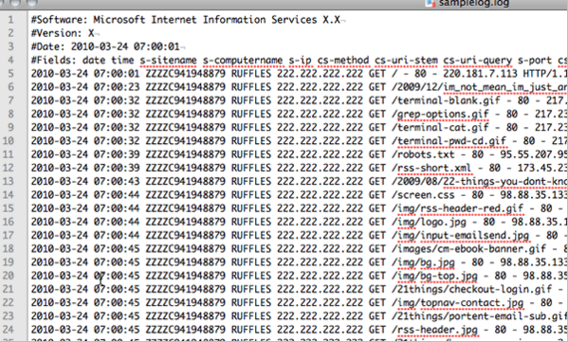
Data Collection
Web Logs

Slide 6
Data Collection
Web Logs
Benefits
  Every web server has an inbuilt capability to create log files whether we want or not. If any other tool for web analytics such as Google analytics has not been activated one can use weblogs to analyze user behavior on their website.
  Weblog is useful source for tracking the behavior of search engine robots.

Slide 7
Data Collection
JavaScript Tags
Java Script tags used to define a client side script.
Script element contains scripting statements, or it may even point to an external script file through the src (source) attribute.
Commonly used image operations, form validation and dynamic changes of the content on the webpage.

Slide 8
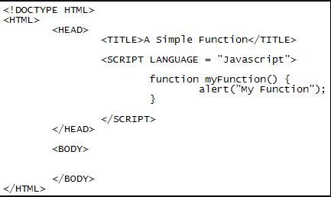
Data Collection
JavaScript Tags

Slide 9
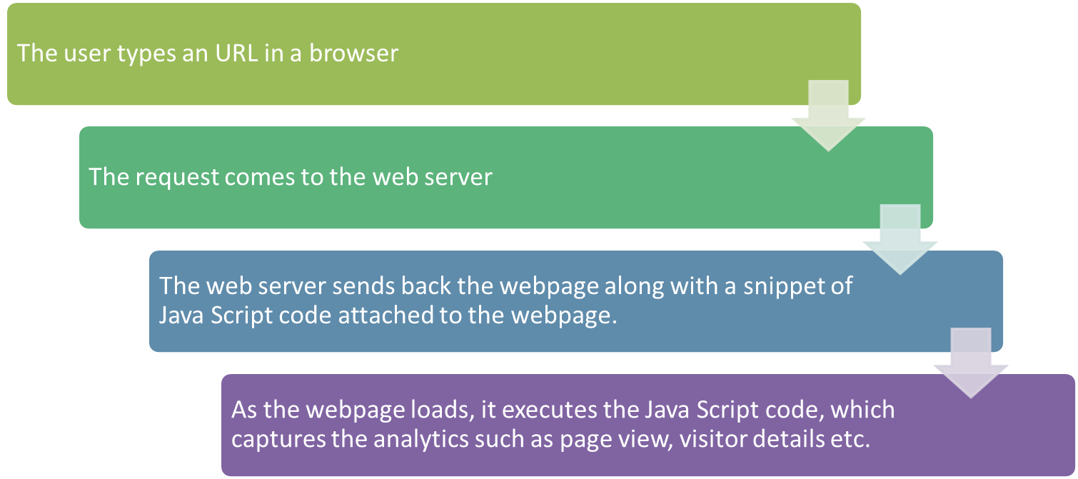
Data Collection
JavaScript Tags
How data capture works with Java Script tagging

